Slide 1
Friends of Fulbright
Convocatoria 2017 Fulbright Argentina & Ministerio de Educacion y Deportes de la Nacion
University of Nebraska at Lincoln

Slide 2
Lincoln, NE
The cornhuskers

Slide 3
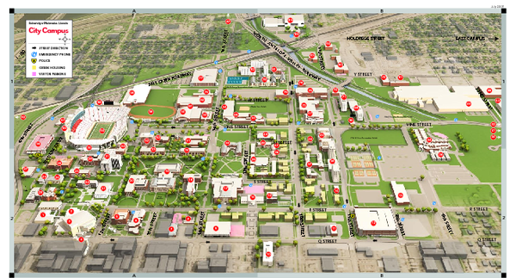
UNL Campus - City campus

Slide 4
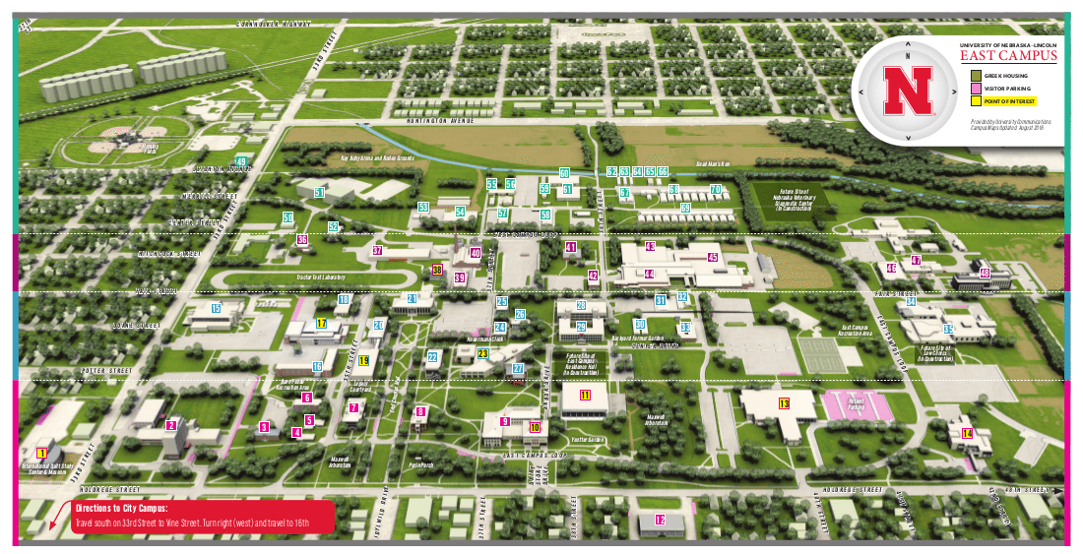
UNL Campus - east campus

Slide 5
El programa
Interpersonal Skills for Leadership
Social Change Leadership Seminar
Agriculture & Innovation Seminar
US Foreign Policy
Community Service
Dairy Products

Slide 6
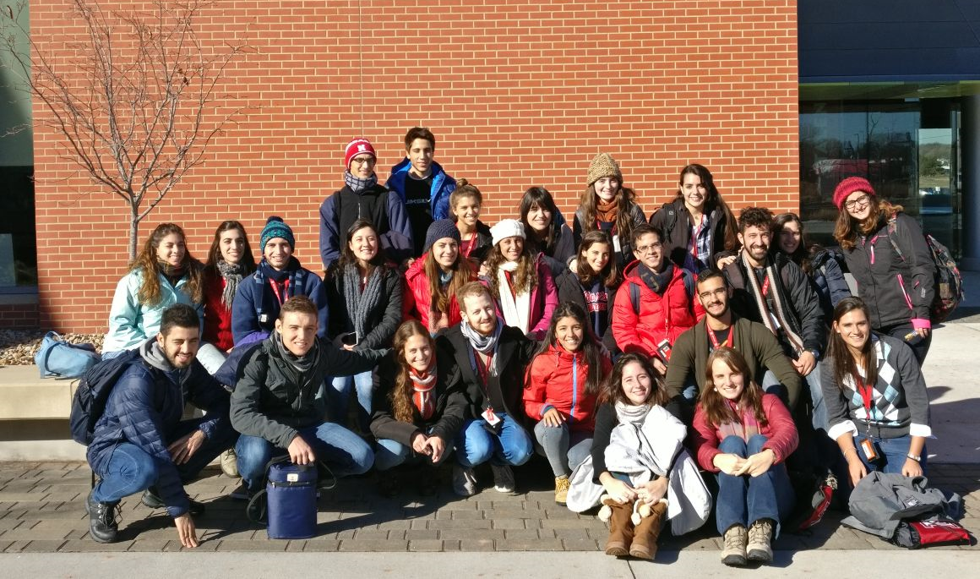
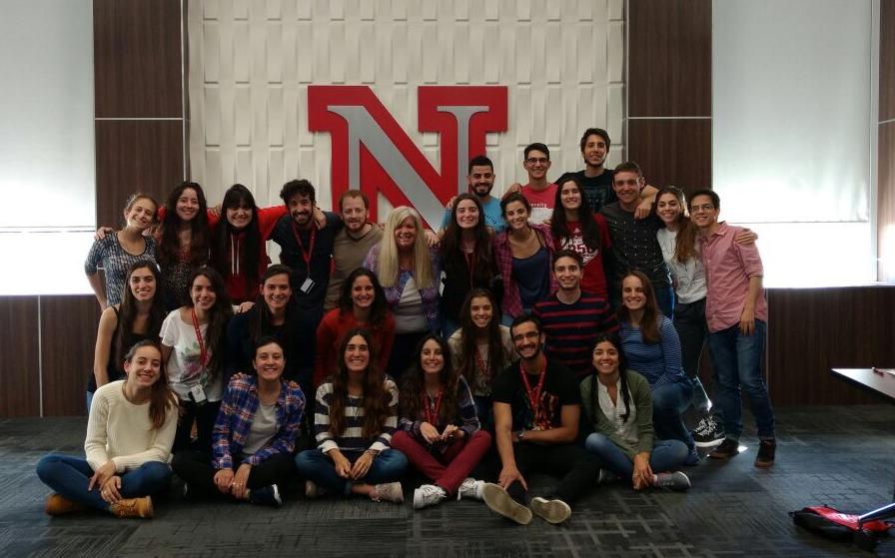
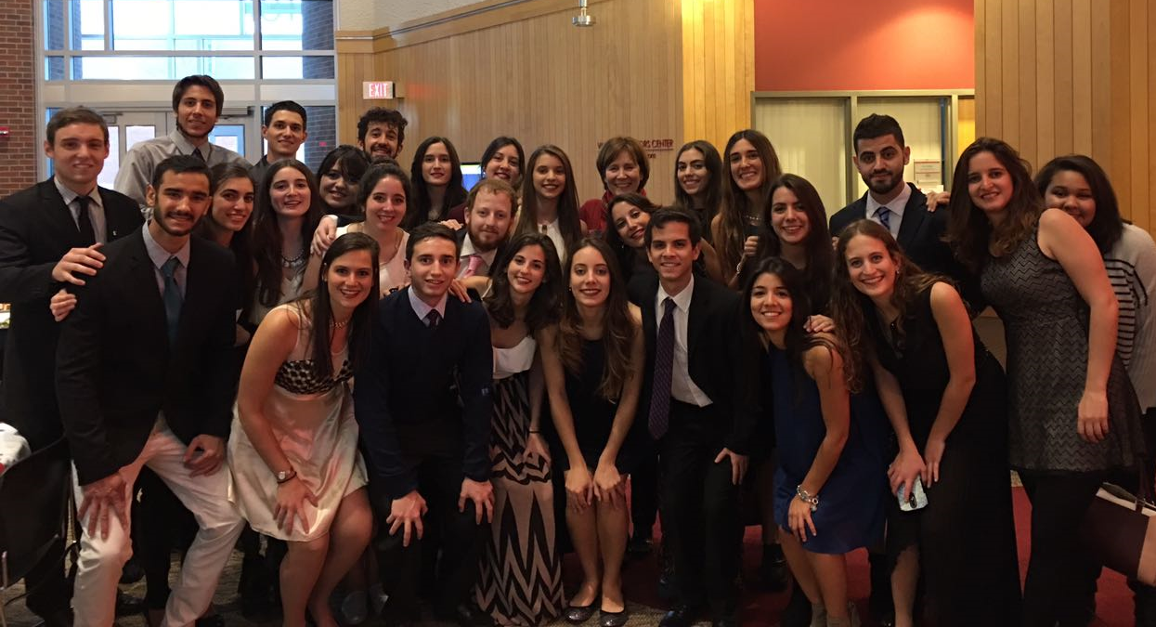
27 Argentinos

Slide 7
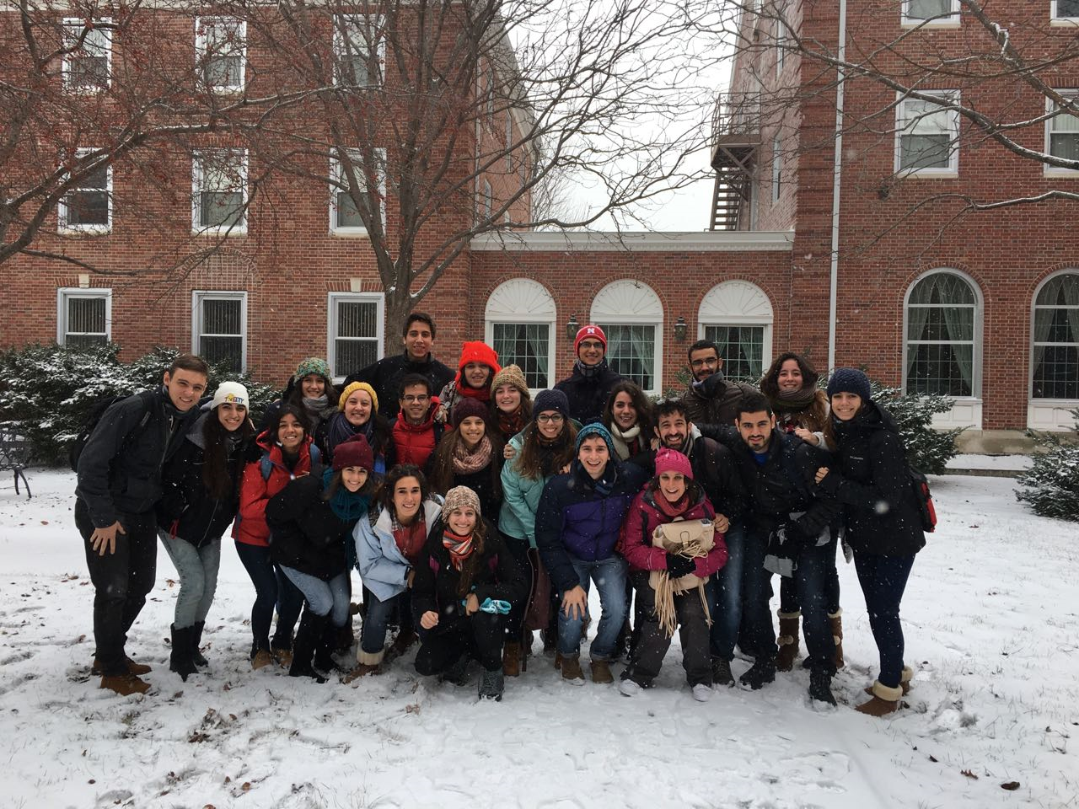
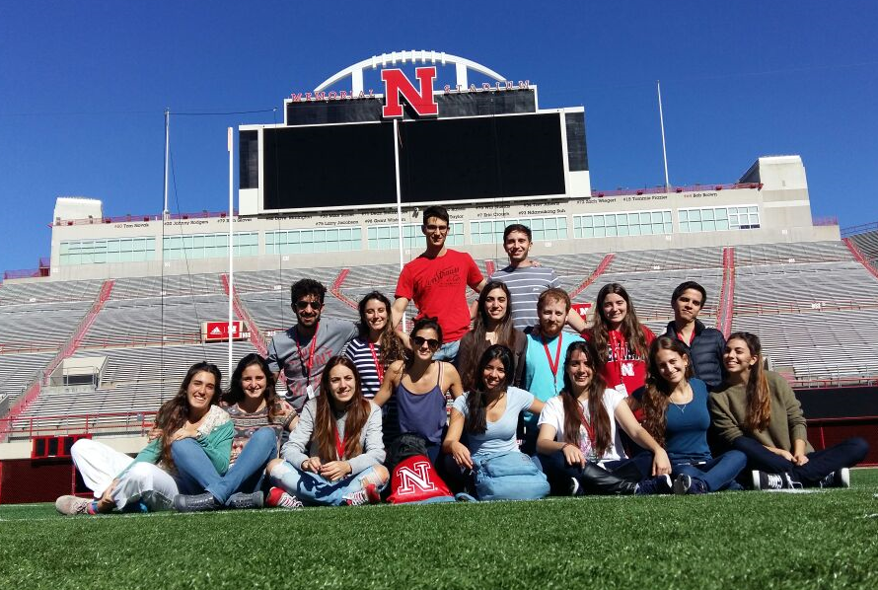
Clima

Slide 8
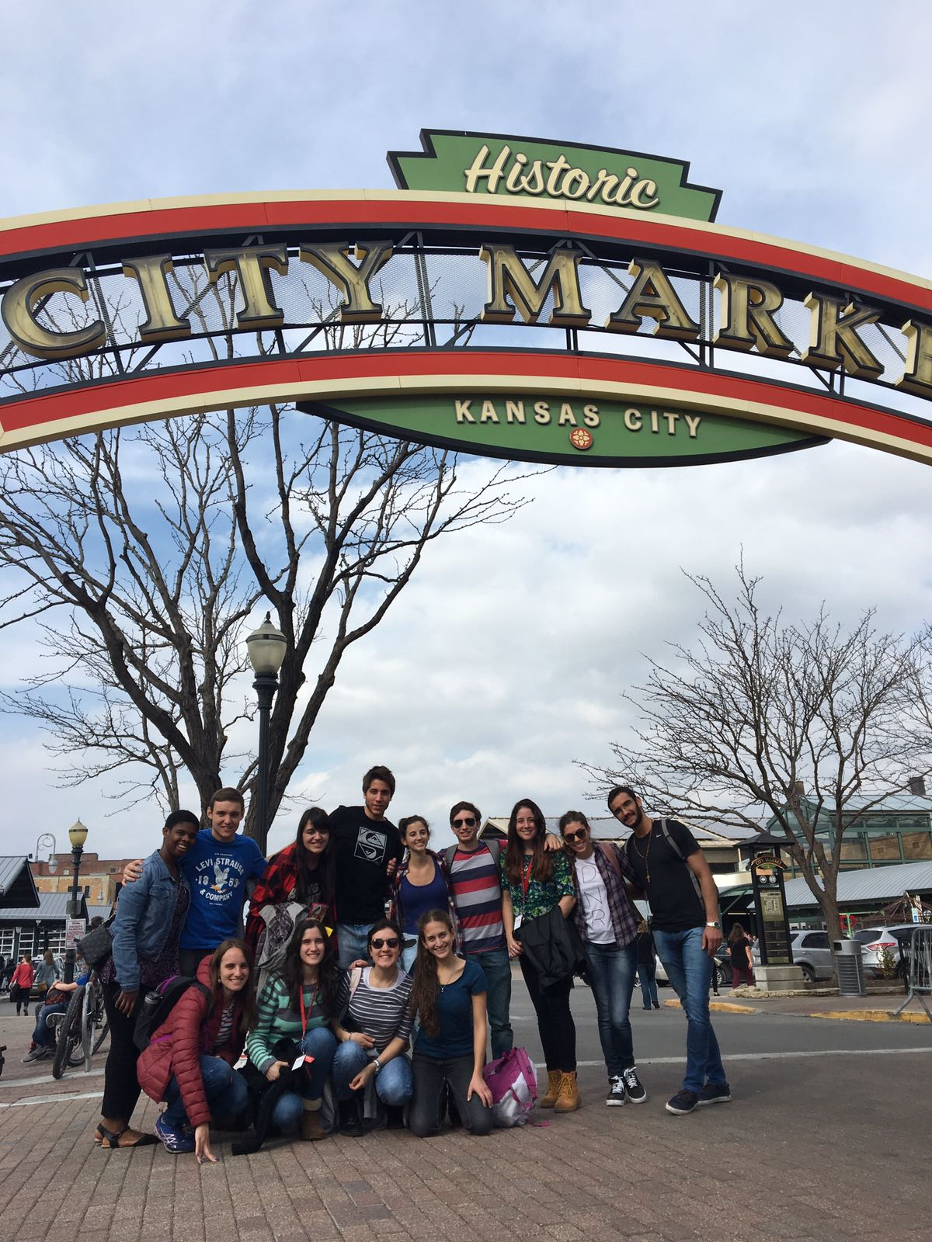
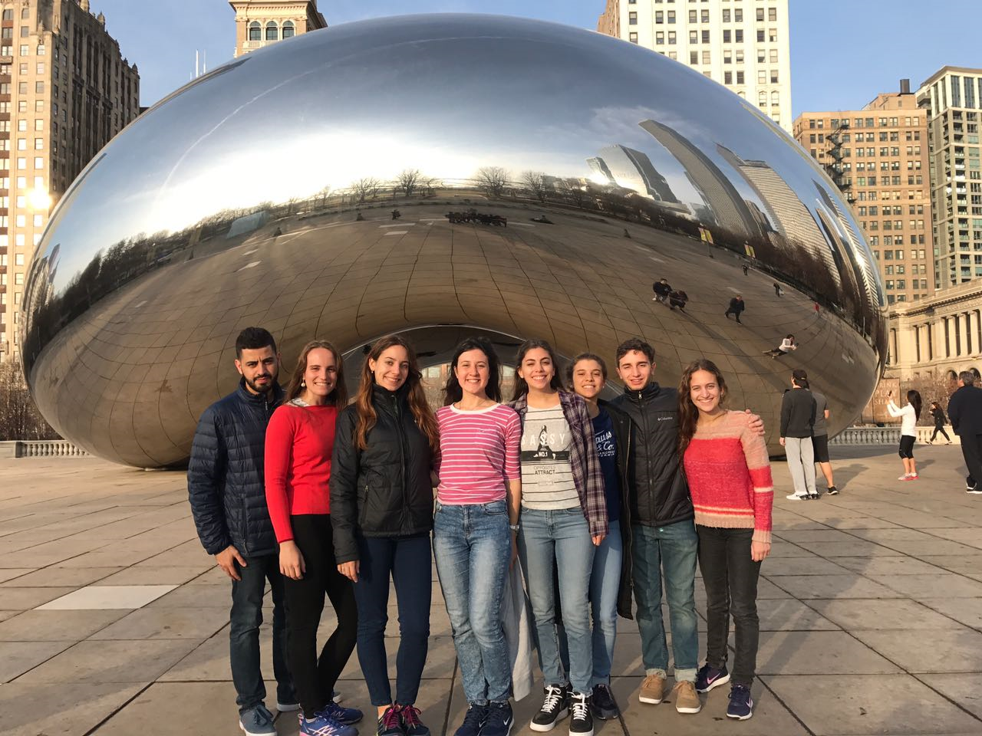
Viajes

Slide 9
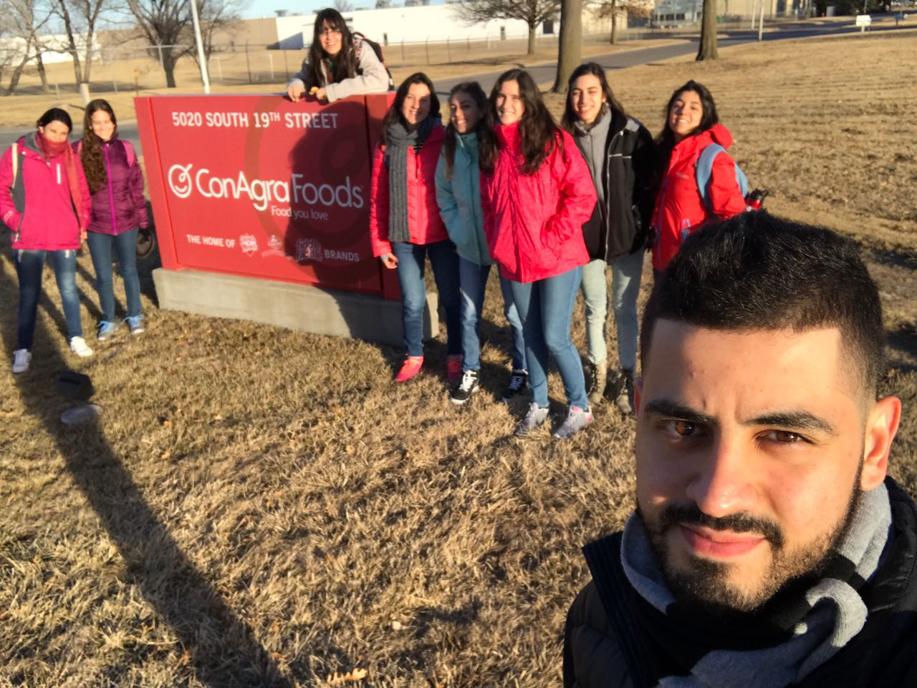
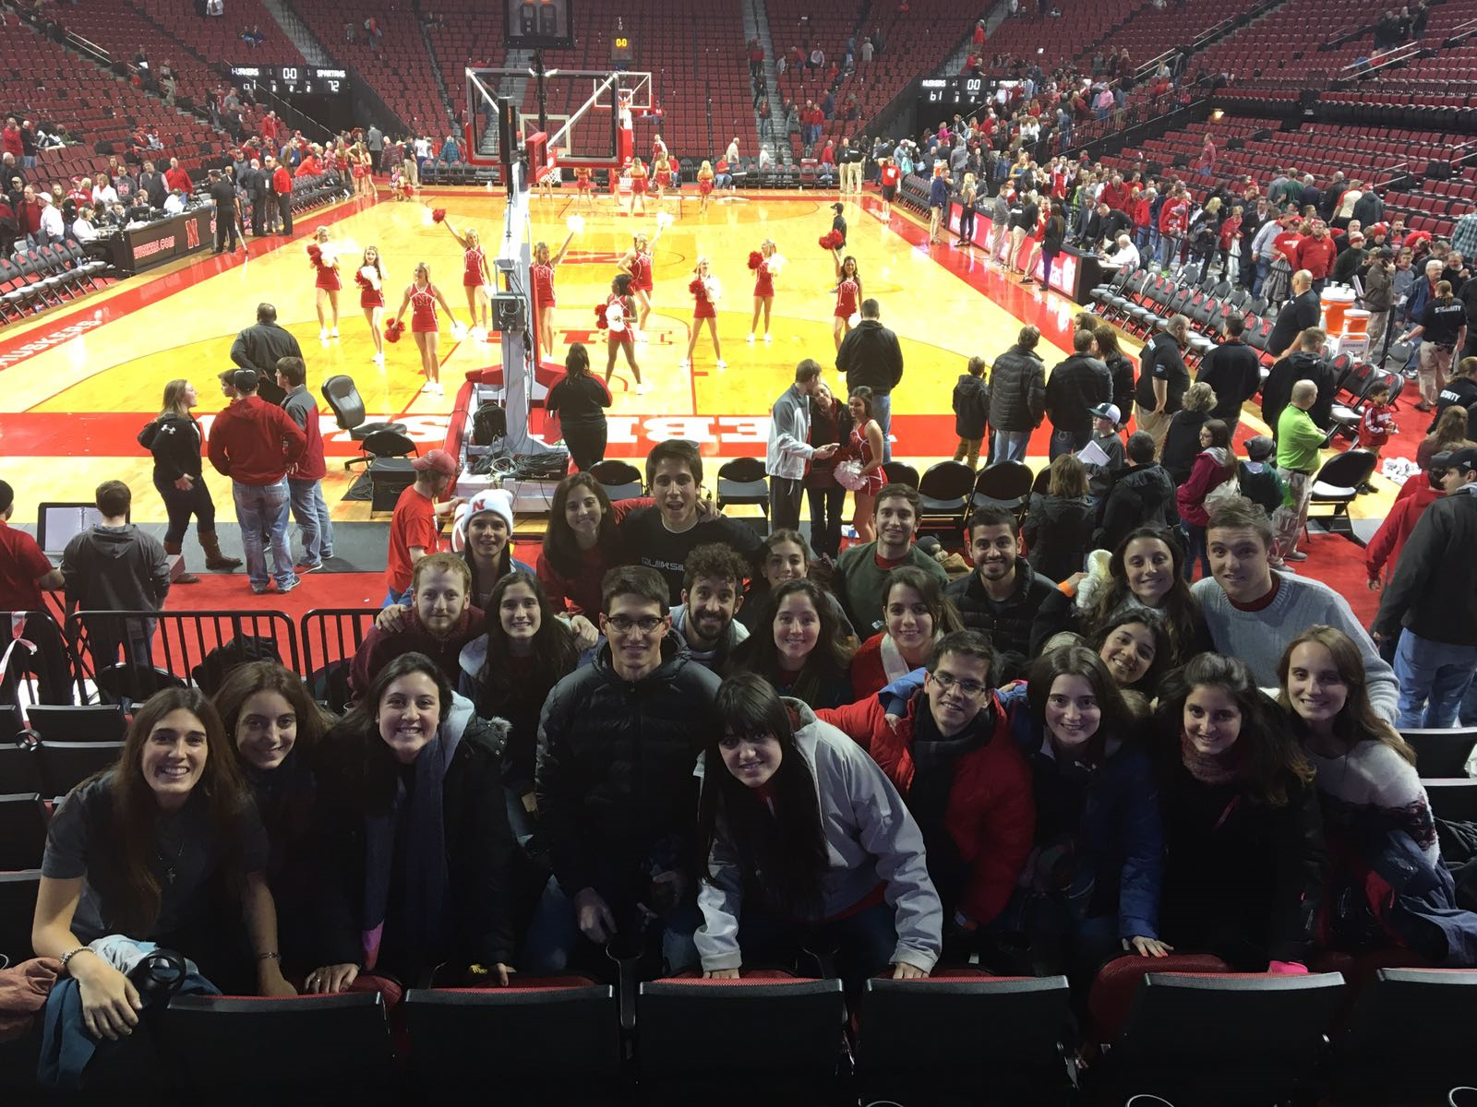
Cornhuskers vs. spartans
ConAgraFoods visit. Popcorn plant
Cornhuskers vs. spartans

Slide 10
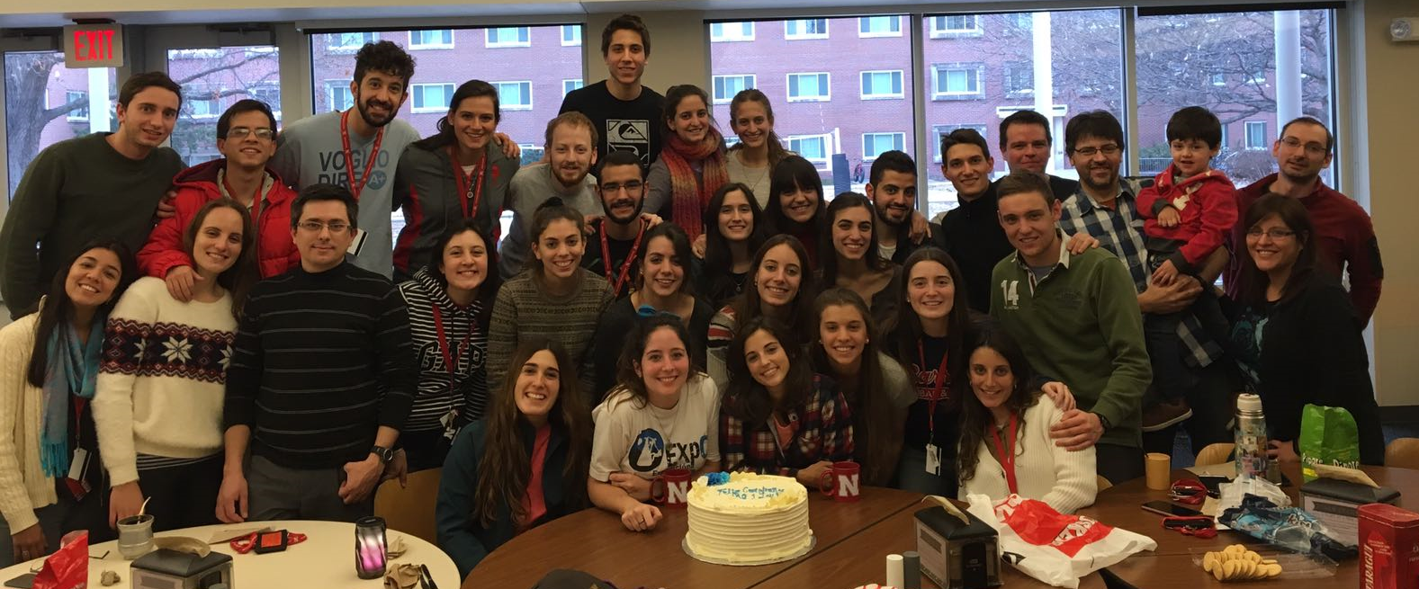
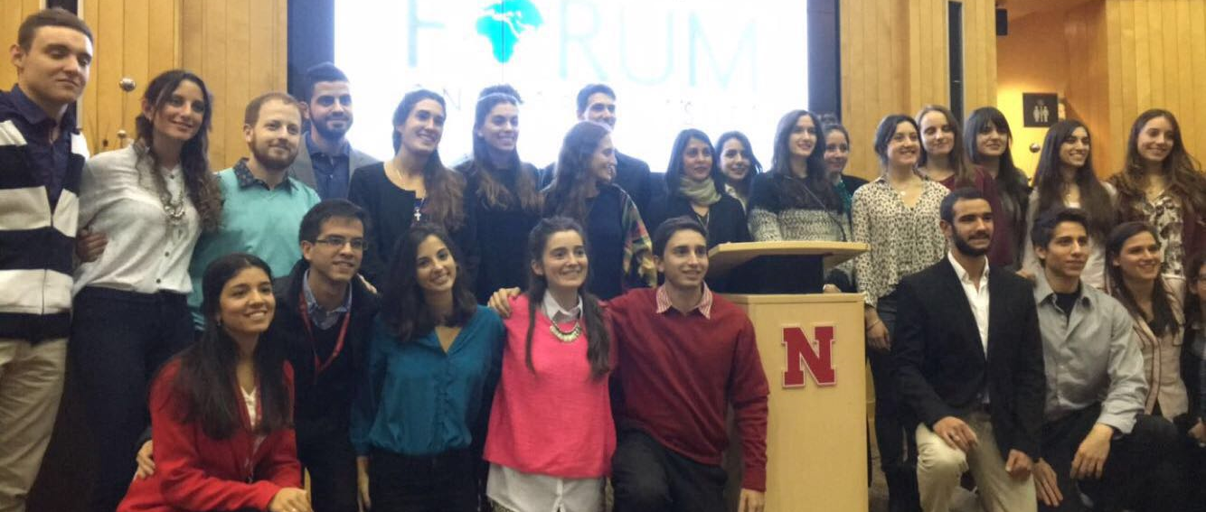
Meeting with Argentinians
Forum on World Issues. Sonia Shah. Pandemics
Forum on World Issues. Sonia Shah. Pandemics

