Slide 1
Tips for writing a good research paper and new paradigms in publishing
Professor K.Niranjan
University of Reading
Editor – Journal of Food Engineering

Slide 2
Scope of the talk
What constitutes a good research paper?
How to approach publishing your research work?
Journal bibliometrics:
What is impact factor?
What are other bibliometric indicators?
What is the link between journal bibliometrics and research quality (if any!)
New paradigms in publishing - “open access”

Slide 3
What constitutes a good research paper?
A paper can only be as good as the research work undertaken.
Before starting to work on the project, ask yourself:
Is the research novel?
What is new and novel about the work?
Is the research driven by scientific hypotheses which experiments or modelling approaches could validate?
How does the work fit within the context of the state of science in a given area? Is the knowledge added going to be incremental? Or will it be a strategic step?
If you do not have satisfactory answers to the above questions, is it worth starting the research work?

Slide 4
HOW to write the paper?
Timing: Consider writing a paper only after a reasonable body of ORIGINAL information has been collected (rule of thumb: 7-10 original figures: and a few tables! – Finalise the figures and tables, and then start drafting the paper)
Developing a figure/Table title: The figure/table title must be very clear, indeed so clear that the title itself must convey to the reader all the results – WITHOUT REFERRING TO THE METATERIALS AND METHODS! The legend must also be very clear.

Slide 5
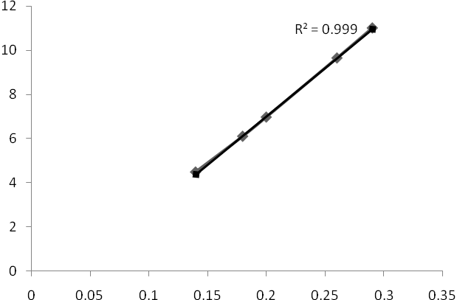
Exercise: How would you caption the figure below?
Minimum spouting velocity
Bed height

Slide 6
How to draft the text of the paper?
First write materials and methods, because this is factual and will give you the momentum to write!
Then start drafting the results and discussion section.
Do not repeat the information given in the figures/tables mechanically
Do not simply say what you see in the figures/table, but explain WHY you find such trends. If you have a sound theory/hypothesis – link the observations; if not, you may speculate – but only to the extent of PLAUSIBILITY. Also discuss your results in the context of earlier related publications
Then draft the CONCLUSIONS
Now begin drafting the INTRODUCTION. This section must introduce the problem, justify why you are investigating the problem AND clearly state the NOVELTY of the work and how it furthers knowledge in the area
FINALLY DRAFT THE ABSTRACT, which will contain a statement of the problem, why you are investigating it, what is novel, your experimental approach and a gist of results and discussion (ALL WITHIN THE NUMBER OF WORDS STIPULATED BY THE JOURNAL – READ INSTRUCTIONS TO AUTHORS CAREFULLY)
LAST BUT NOT LEAST: References and Abbreviations (PLEASE REFER TO INSTRUCTIONS!)

Slide 7
Review papers
UK system discourages this, unless we can prove significant original content!
Most countries treat this on par with original papers
Synthesis of knowledge in a given area
Citations are very high (so you can become popular!)
Costs very little!!!

Slide 8
Journal Bibliometrics
JOURNAL IMPACT FACTOR
EIGEN FACTOR
h-INDEX (the author based metric)

Slide 9
Web of Science
Thomson Reuters (formerly ISI) has a huge database, Web of Science, that…
Indexes selected journals > 8,000 science; > 3,000 social science journals; > 1,800 Arts & Humanities
Tracks “cited references” and “times cited”
Journal Citation Reports (JCR) keeps track of citations at the journal level. A new edition comes out every Spring.

Slide 10
Traditional IMPACT FACTOR
It is the ratio between citation and recent citable items published in a journal; or the average number of citations received per article.
It is published by Thomson Reuters (Journal Citation Reports®)

Slide 11
Journal of Food Engineering (Category, Engineering, chemical) ISSN 0260-8774
Calculation of 2012 impact factor (published in 2013)
Number of SOURCE articles published in 2011: 369
Number of SOURCE articles published in 2010: 431
The number of times the articles published in 2011 and 2010 were cited in 2012: 1820
Impact factor = 1820/(369+431) = 2.276
The total cites in 2012 = 14629
NOTE THAT CITATIONS REFER TO ALL TYPES OF CITATIONS – BOOK REVIEWS, LETTERS TO EDITORS, NEWS, ETC

Slide 12
Immediacy Index – Journal of Food Engg
Journal Immediacy Index 2012
Number of items published in 2012: 424
Number of cites in 2012 to these items: 178
Immediacy index 178/424 0.42
Journal Immediacy Index 2011
Number of items published in 2011: 369
Number of cites in 2012 to these items: 115
Immediacy index 115/369 0.31

Slide 13
This is a snap-shot!
Some disciplines may use older material more or take time to cite new research – this is true of Food and Biotech
5-year impact factor seems more relevant

Slide 14
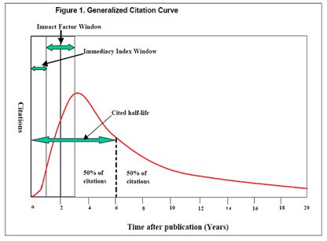
Generalised citation curve

Slide 15
Caveats
Thus, journals publishing non source items could have inflated Impact factors
If we plot % citation versus % articles, the distribution is skewed. Is it valid to take an average citation over a non linear variation?
% citations
75%
% articles
25%

Slide 16
Caveats…continued
Citation behaviour within an area and across different areas are very different!
The impact factor of journals with very high citation in a given area is very high and it tails off rapidly
Journal | Citations | Impact factor
New England J Med | 216752 | 47.05
Lancet | 152843 | 30.76
British Medical J | 71175 | 13.67
Medicine | 5246 | 5.054
British Medical Bulletin | 2685 | 2.9

Slide 17
Caveats…continued
Average impact factors for journals across different areas are very different
DO NOT COMPARE IMPACT FACTORS ACROSS AREAS
Subject Area | Average Impact factor
Biochemistry, Genetics, Molecular Biology | 5.8
Immunology Microbiology | 3.5
Chemical Engineering | 2.4
Mathematics | 0.9
Arts and Humanity | <0.5

Slide 18
Caveats…continued
Biased toward English-language journals (mainly published in USA/EU/Australia!)
ISI has recently added several hundred non-English journals
Worth finding out how many Spanish journals have been added in food and biotech areas (ask your librarian!)

Slide 19
Other bibliometrics – Eigen factor
The Eigenfactor of a journal J in year X is defined as the percentage of weighted citations received by J in X to any item published in (X-1), (X-2), (X-3), (X-4), or (X-5), out of the total citations received by all journals in the dataset. Only citations received from a journal other than J are counted. The Eigenfactor is not corrected by article count, and so is a measure of the influence of a particular journal; bigger and highly-cited journals will tend to be ranked highly.
Eigenfactor scores are measures of a journal's importance

Slide 20
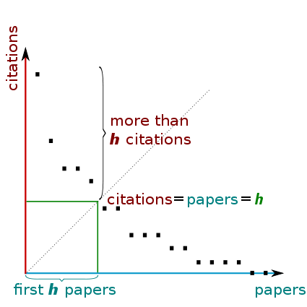
The h-index
A scientist has index h if h of his/her N_{p} papers have at least h citations each, and the other (N_{p} − h) papers have no more than h citations each.

Slide 21
Potential for exploitation of IF…
Although journal publishers cherish impact factor status, it is only recently that their potential for exploitation has been reported in popular press. Wall Street Journal in 2006 named and shamed journals that attempted to manipulate the impact factors
The impact factor – once a simple way to prioritise scientific journals for budget allocation – has become “an unyielding yardstick for hiring, tenure and grants” (Chronicle for higher education)
Is the impact of impact factors decreasing? (Documentation, Vol 64, 2008)

Slide 22
San Francisco Declaration on Research Assessment (DORA)
Annual Meeting of the American Society for Cell Biology convened in San Francisco, California, in December 2012 came up with a declaration…….
The Impact Factor is the most popular numerical measure of a scientist's work. Despite many well-documented flaws, the Impact Factor is commonly used in recruitment, appointment, and funding decisions. A diverse group of stakeholders is now making a concerted effort to combat misuse of the Impact Factor and is calling for the development of more accurate measures to assess research.¹The general recommendation of DORA is that all stakeholders in the research community:
Do not use journal-based metrics, such as Journal Impact Factors, as a surrogate measure of the quality of individual research articles, to assess an individual scientist's contributions, or in hiring, promotion, or funding decisions…….
PLEASE SEE http://am.ascb.org/dora/

Slide 23
DORA advice for research assessment in an institution
“Be explicit about the criteria used to reach hiring, tenure, and promotion decisions, clearly highlighting, especially for early-stage investigators, that the scientific content of a paper is much more important than publication metrics or the identity of the journal in which it was published.”
“For the purposes of research assessment, consider the value and impact of all research outputs (including datasets and software) in addition to research publications, and consider a broad range of impact measures including qualitative indicators of research impact, such as influence on policy and practice.”

Slide 24
Research Excellence Framework in UK (2014) which will determine funding from 2015 onwards
REF1a/b/c: Information on staﬀ in post on the census date, 31 October 2013, selected by the institution to be included in the submission.
REF2: Details of publications and other forms of assessable output which they have produced during the publication period (1 January 2008 to 31 December 2013). Up to four outputs must be listed against each member of staﬀ included in the submission.
REF3a/b: A completed template describing the submitted unit’s approach during the assessment period (1 January 2008 to 31 July 2013) to enabling impact from its research, and case studies describing speciﬁc examples of impacts achieved during the assessment period, underpinned by excellent research in the period 1 January 1993 to 31 December 2013.
REF4a/b/c: Data about research doctoral degrees awarded and research income related to the period 1 August 2008 to 31 July 2013.
REF5: A completed template describing the research environment, related to the period 1 January 2008 to 31 July 2013.

Slide 25
Open Access
Open access (OA) describes the public's unrestricted online access to peer reviewed articles published in scholarly journals.
Different financial model
Currently subscription funds publication
If everything is open access, then library budgets can be diverted to the institution paying for publication of articles by the authors in the instituition.

Slide 26
Types of Open access - 1
Open access journals or Gold Open access:
HIGH QUALITY JOURNALS WHERE ALL ARTICLES ARE OPEN ACCESS
MAINTAIN RIGOROUS PEER REVIEW
FINANCIALLY SUPPORTED BY PUBLICATION FEE
NO SUBSCRIPTION CHARGES
RANGE OF USER LICENCES

Slide 27
Types of Open access -2
Open access articles
Articles have open access in a subscription journal
Allows authors to publish open access in reputed high quality journals
Maintains strict peer review
Choice of user licences
Range of publication fee
No “double dipping”
PEER REVIEW PROTOCOLS REMAIN UNAFFECTED

Slide 28
Types of open access - 3
Open Archive
SUBSCRIPTION JOURNALS MAKING ARTICLES FREELY AVAILABLE AFTER A TIME DELAY (VARIES FROM 6 MONTHS AFTER PUBLICATION)

Slide 29
Types of Open Access - 4
Green Open Access
POSTING MANUSCRIPTS ON INSTITUTIONAL OR SUBJECT REPOSITORIES (AFTER A TIME DELAY)
COST PAID BY SUBSCRIPTIONS

Slide 30
State of play – Open access
In technology and Engineering, even today, 85% of the papers are published in subscription journals; 14% green open access and 1% Gold Open access
Situation is changing – watch this space
What is the effect of Open access publishing on impact factors and h-index? UNCLEAR

Slide 31
FINALLY……PLEASE BE CONSIDERATE!
Please agree to review a paper if you are invited to………!
Scholarly publication relies on researchers reviewing colleagues’ papers
It is a communal responsibility!

Slide 32
The Evolution of Intellectual Freedom”, by Jorge Cham, 20 July 2011Copied from: http://www.networkedresearcher.co.uk/wp-content/files/2011/07/phd072011s.gif

Slide 33
Thank you!

